Slide 1
4XKanda_1276_NoBME Schematic Review Report
Schematic file: 4XKanda_1276_NoBME.sch
Date: 12/20/2021

Slide 2
Summary
No. | Description | Status
1 | Incorrect the value of input capacitor (C5, C7, C15, C22) at IC1, IC11, IC16, IC6 (P/N:CJT1117-3.3) | OPEN
2 | Incorrect the value of output capacitor (C6, C8, C16, C23) at IC1, IC11, IC16, IC6 (P/N:CJT1117-3.3) | OPEN
3 | Missing capacitor at VCC pin of IC8, IC13, IC18, IC54 (P/N: ATGM336H) | OPEN
4 | Missing capacitors at “3.3V” pin of U1, U2, U3, U4 (P/N: RFM69HCW-315S2) | OPEN
5 | Missing capacitors at “3.3V” pin of IC3, IC5, IC10, IC15 (P/N: ESP-WROOM-03) | OPEN
6 | High power dissipation at LDO CJT1117-3.3 | OPEN

Slide 3
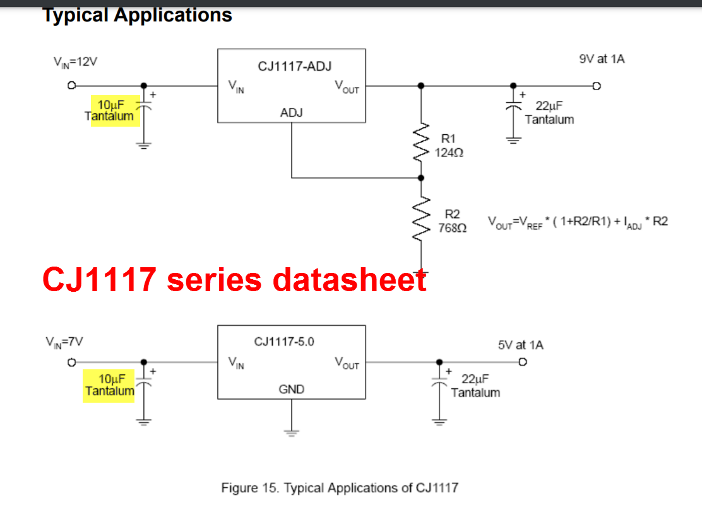
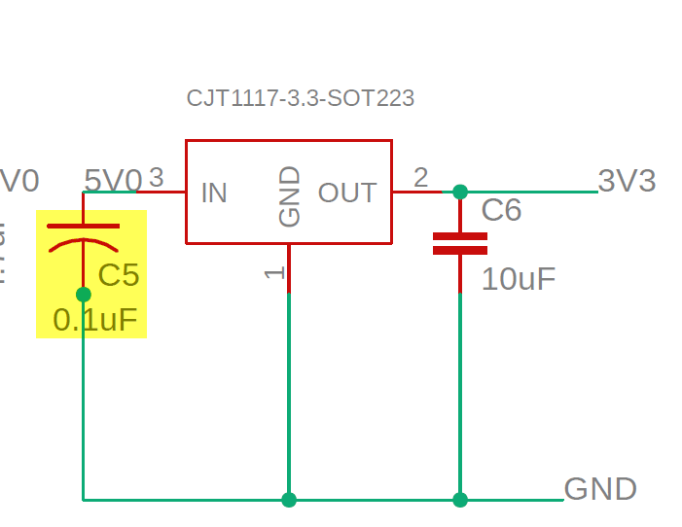
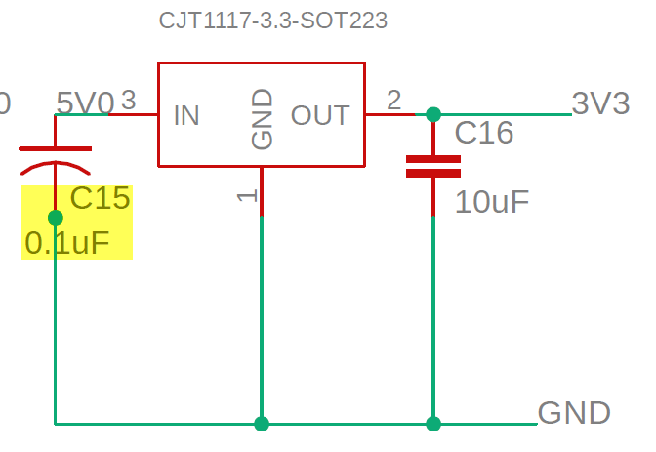
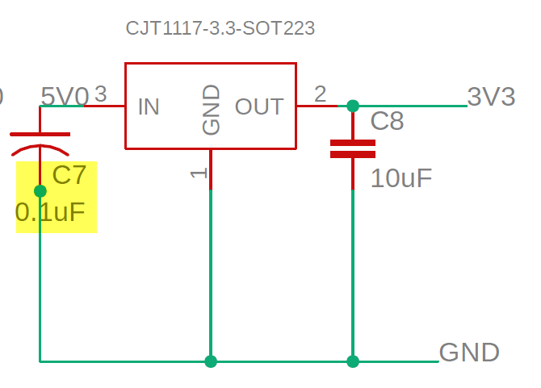
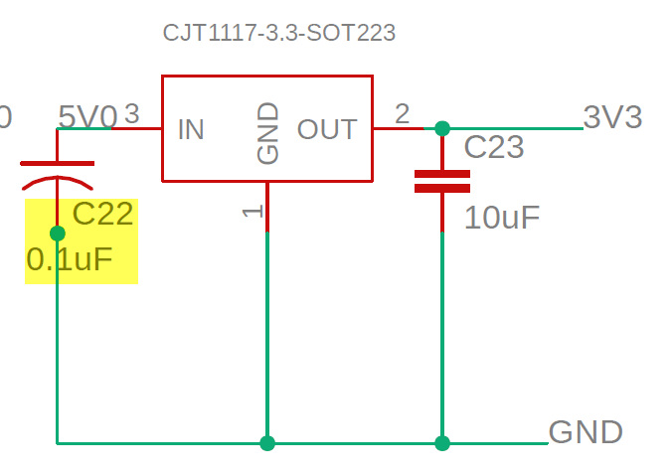
Issue 1: Incorrect the value of input capacitor (C5, C7, C15, C22) at IC1, IC11, IC16, IC6
(P/N:CJT1117-3.3)
Per CJ1117 series datasheet, the value of input capacitor (C5, C7, C15, C22) should be 10uF, instead of 0.1uF
Solutions/Recommendation:
Please double check and change the value of C5, C7, C15, C22 to 10uF

Slide 4
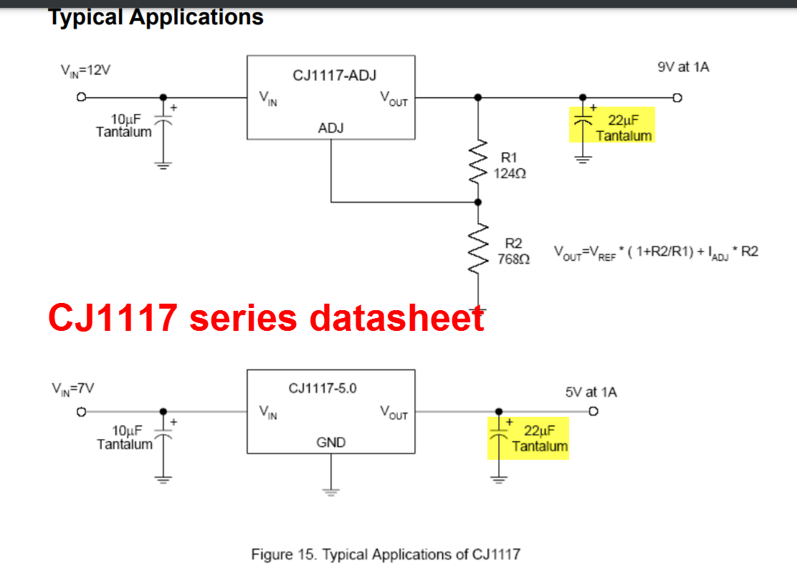
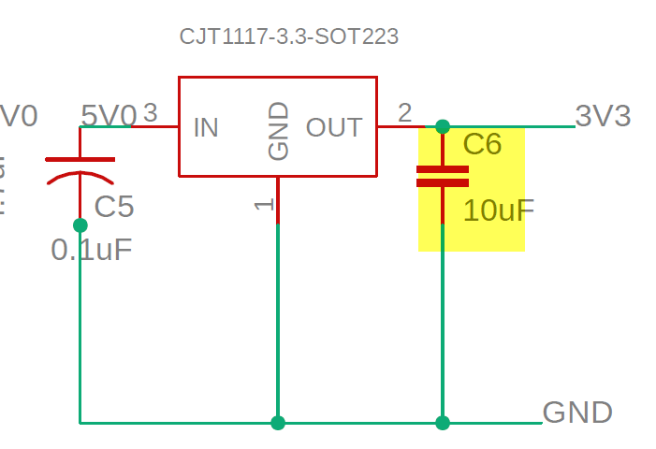
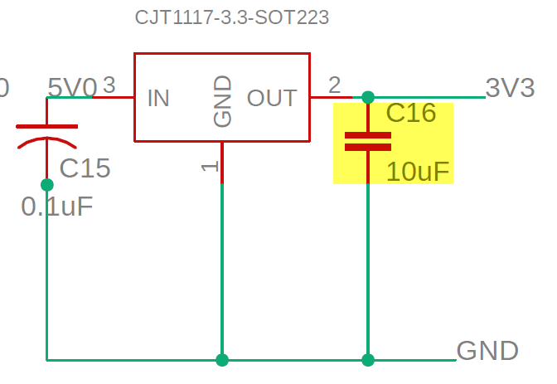
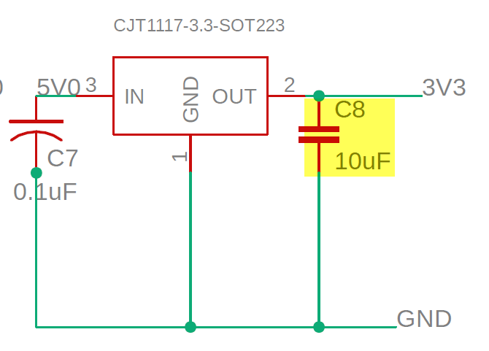
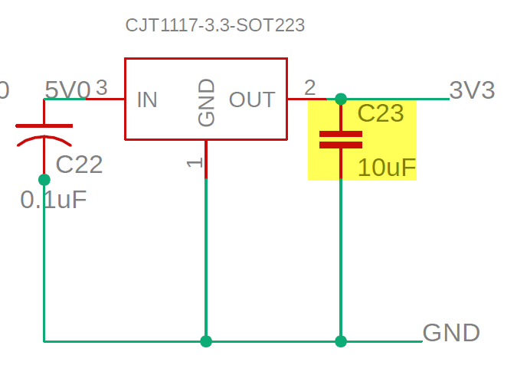
Issue 2: Incorrect the value of output capacitor (C6, C8, C16, C23) at IC1, IC11, IC16, IC6
(P/N:CJT1117-3.3)
Per CJ1117 series datasheet, the value of output capacitor (C6, C8, C16, C23) should be 22uF, instead of 10uF
Solutions/Recommendation:
Please double check and change the value of C6, C8, C16, C23 to 22uF

Slide 5
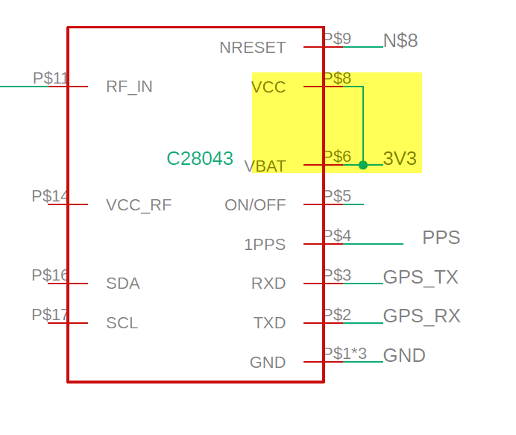
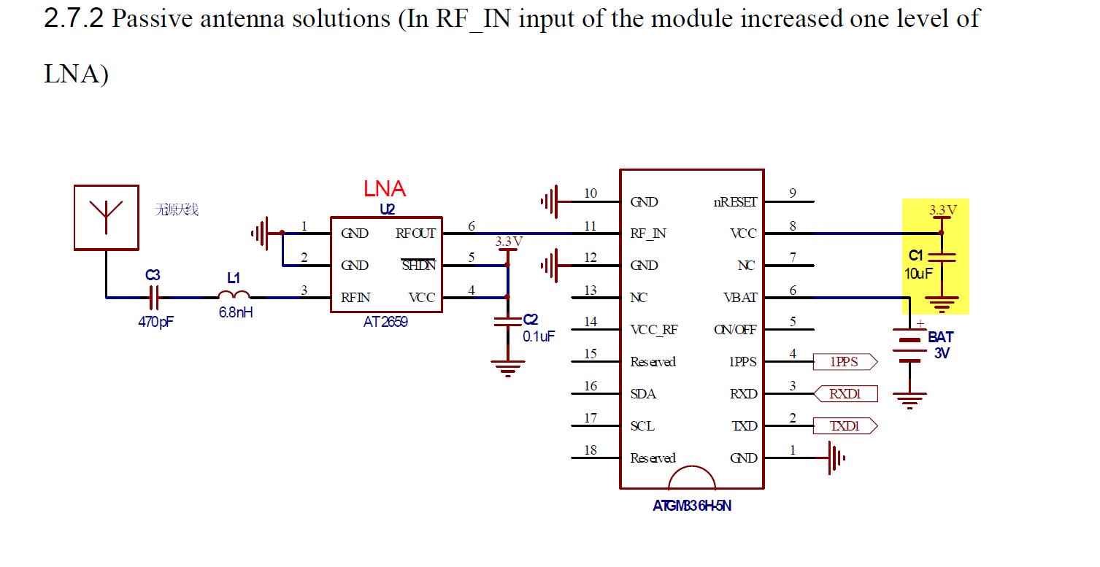
Issue 3: Missing capacitor at VCC pin of IC8, IC13, IC18, IC54 (P/N: ATGM336H)
Solutions/Recommendation:
Please double check and add 10uF at VCC pin of IC8, IC13, IC18, IC54 (P/N: ATGM336H)

Slide 6
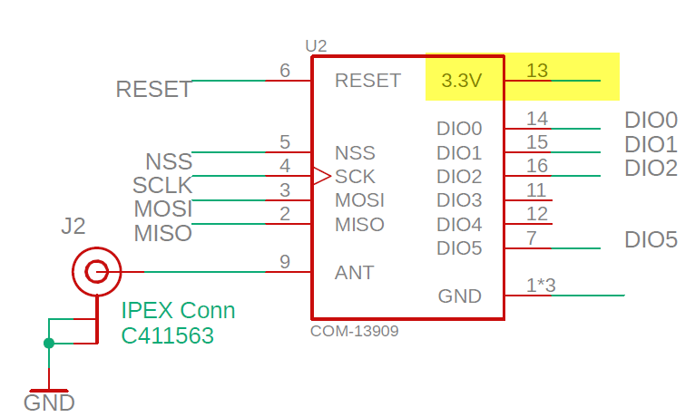
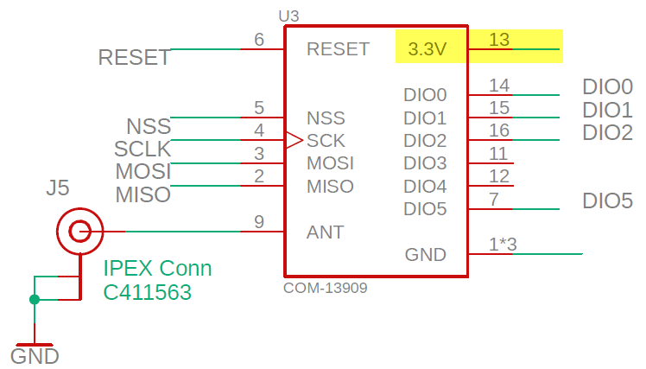
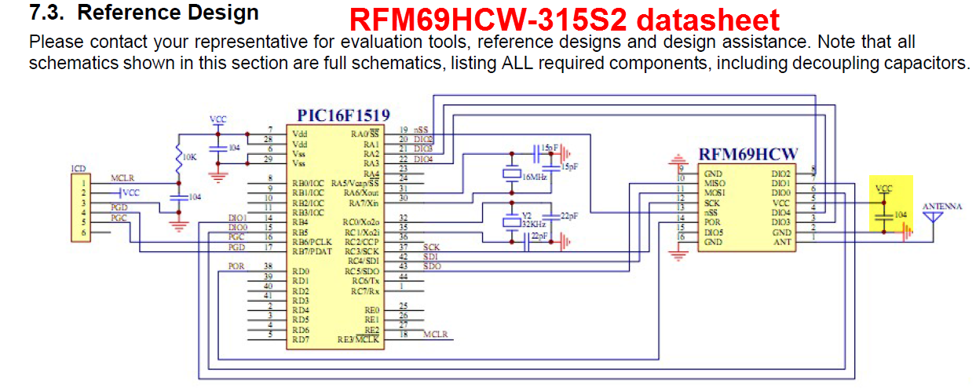
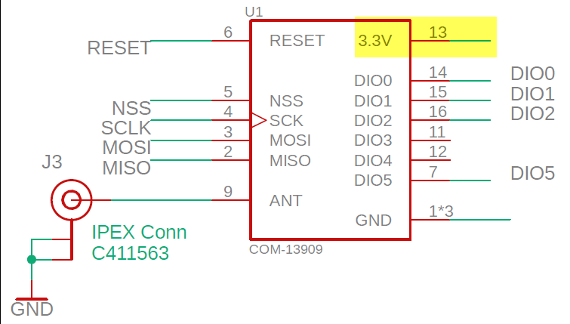
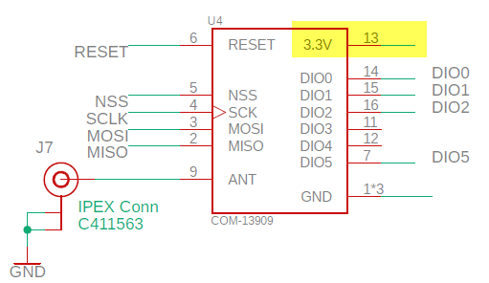
Issue 4: Missing capacitor at “3.3V” pin of U1, U2, U3, U4 (P/N: RFM69HCW-315S2)
Solutions/Recommendation:
Please double check and add 0.1uF at “3.3V” pin of U1, U2, U3, U4 (P/N: RFM69HCW-315S2)

Slide 7
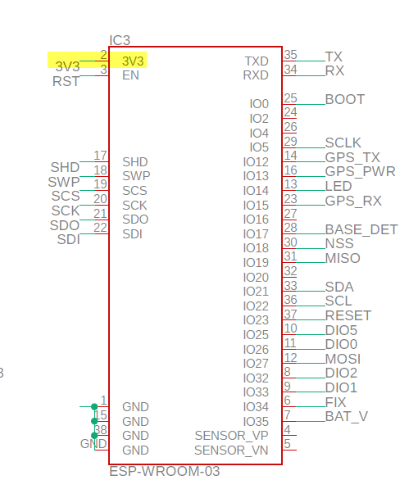
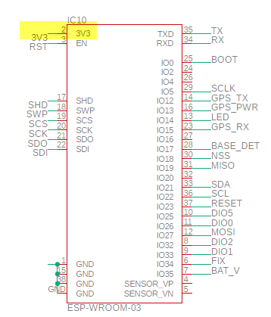
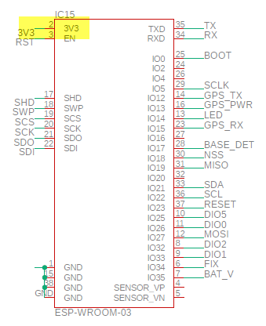
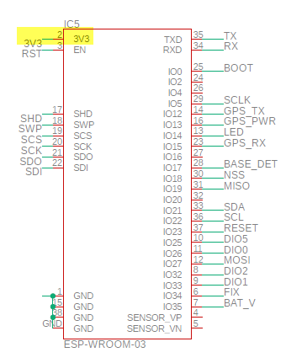
Issue 5: Missing capacitor at “3.3V” pin of IC3, IC5, IC10, IC15 (P/N: ESP-WROOM-03)
Solutions/Recommendation:
Please double check and add 0.1uF at “3.3V” pin of IC3, IC5, IC10, IC15 (P/N: ESP-WROOM-03)

Slide 8
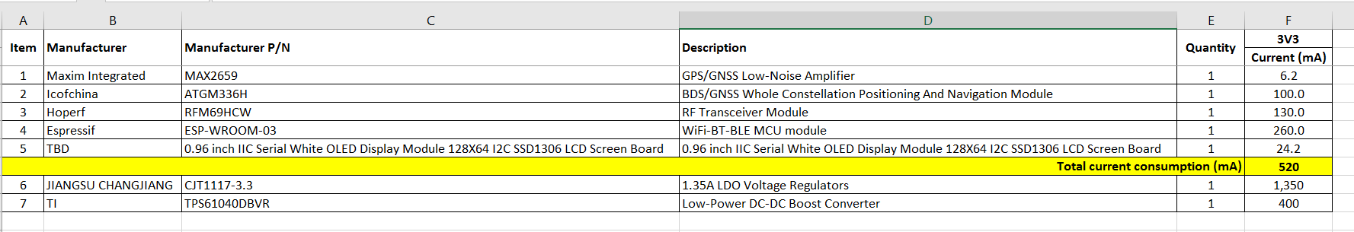
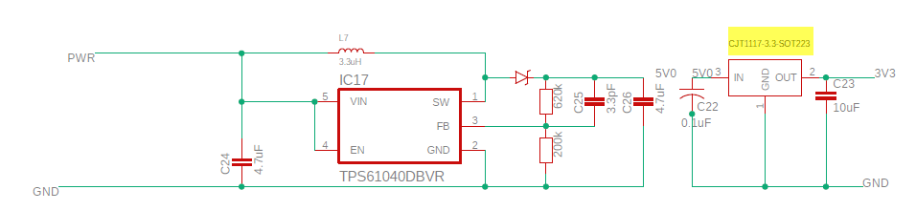
Issue 6: High power dissipation at LDO CJT1117-3.3
The maximum power consumption on each module is calculated about 520mA. The power dissipation at LDO
CJT1117-3.3 is about (5-3.3)*0.52 = 0.88W. This may cause hot issue.
One more thing, the maximum current consumption of 5V0 rail is 520mA. But the maximum output current of Boost converter (TPS61040DBVR) is 400mA. Please double check
Solutions/Recommendation:
We need to re-design the board with a new buck regulator (example ADP2107ACPZ-3-3-R7 if VIN > 3.6V) or a new boost/buck regulator (example LTC3538EDCB-TRPBF).
Please provide characteristics of power input (voltage range, ripple noise), then we will study and provide the best solution.

